Slide 1

Scalar and Vector
In science we study many things. Some of the things we can study
have a quantity attached to them.

Slide 2
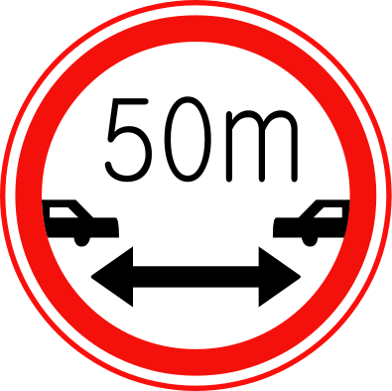



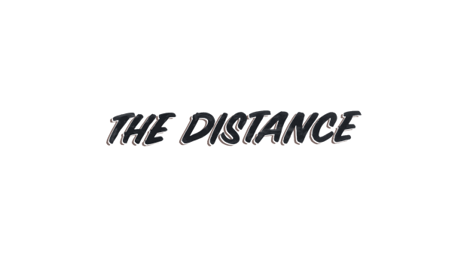




Scalar and Vector
A lot of the quantities we study don’t have a direction to them.
For example…
Measured in Joules.
No direction

Slide 3


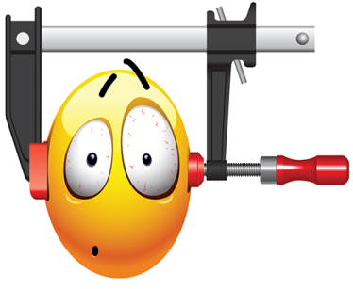



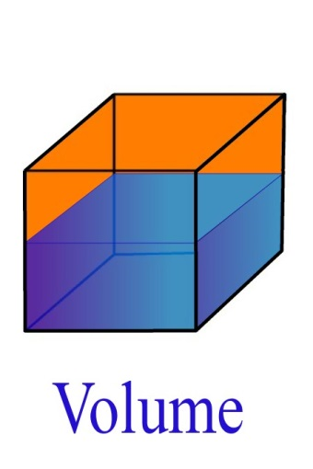




Scalar
Scalar and Vector
If something in science has a
quantity/size/magnitude
but no direction we say it is scalar.

Slide 4
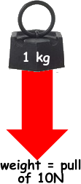

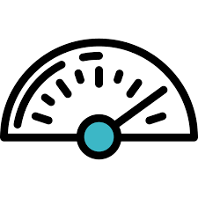


Vector
There are special quantities in science that
have both a size and a direction.
We call these VECTORS.
Mass is a scalar. Weight is vector because it is
related to the pull of gravity which has direction.

Slide 5

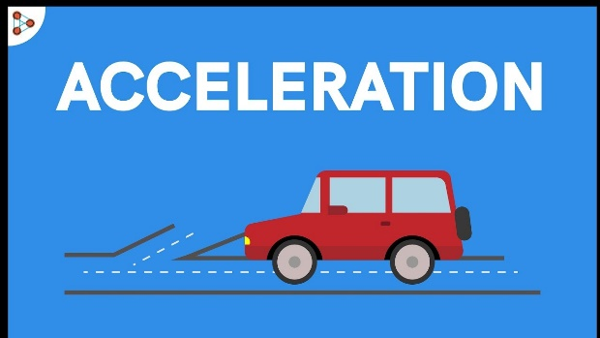


Sort these into scalar and vector quantities.

Slide 6

Activity: Complete the part of your worksheet.

Slide 7
EXT: Match the words in green to the correct meanings in other boxes.
Vector
Scalar
Magnitude
Arrow
Proportional
As one value increases in size
the arrow increases in size
The amount, size or
quantity
Examples would be
Acceleration, velocity, Force
A physical quantity that has a
magnitude but no direction
A word for the amount,
size or quantity
A physical quantity that
has magnitude and direction
Examples would be
Time, distance and energy
Notes:
Extension work for faster students

Slide 8
Distance and Displacement
IS
SCALAR
NO
DIRECTION
Distance is: The length of a path between two points.
  Distance is measured according to the amount of distance involved
      EX: Marble rolls= mm or cm (millimeters or centimeters)
        Car travels= m or Km ( meters or kilometers)

Slide 9
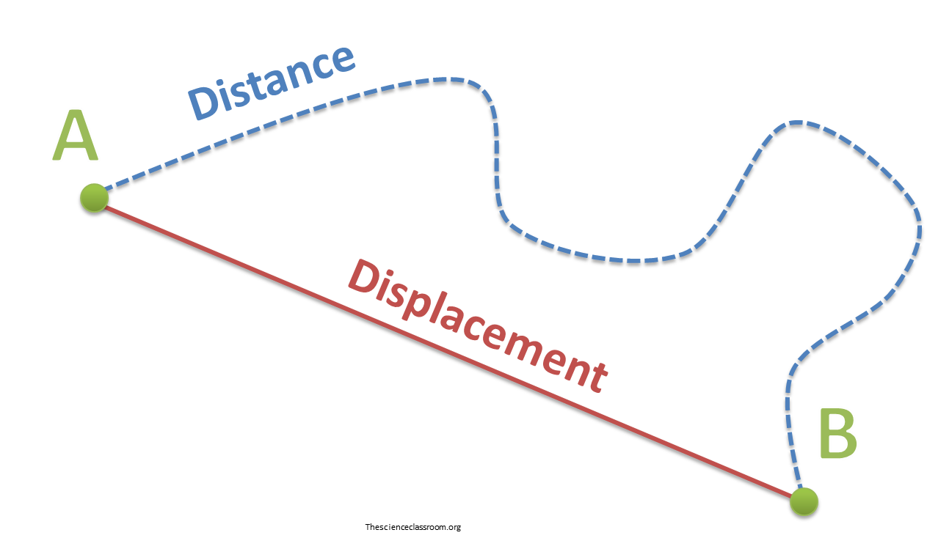

What was the distance of our journey?
2.3 km

Slide 10
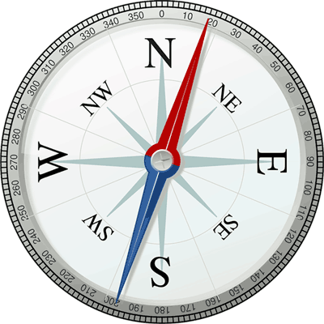

Distance and Displacement
+
=
DISPLACEMENT
Displacement: the direction from the starting point AND the length of a straight line from the starting point to the ending point.

Slide 11
What was the displacement of our journey?
2.3 km
1.7 km
Displacement: the direction from the starting point AND the length of a straight line from the starting point to the ending point.

Slide 12


displacement
distance
Notes:
Say the phrase in a gangsta style. Get students to say the phrase with their best gangsta accent. LOLs all round

Slide 13
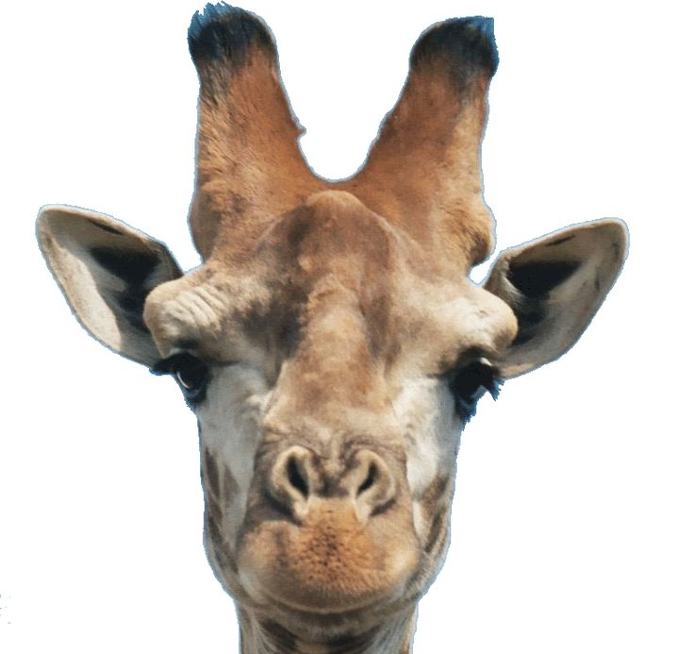

1. Billy started at A, crawled around the whole perimeter of the triangle and ended up at B. What was his distance and displacement?
2. Johnno the giraffe walked around from point A to C.
Calculate the distance and displacement. Hint: Pythagoras
5m
A
A
D
4m
9m
7m
6m
B
C
B
C
3m

Slide 14
1. Billy started at A, crawled around the whole perimeter of the triangle and ended up at B. What was his distance and displacement?
Distance = 18cm
Displacement = 4cm
2. Johnno the giraffe walked around from point A to C.
Calculate the distance and displacement. Hint: Pythagoras
Distance = 14cm
Displacement = 10.3cm
5m
A
A
D
4m
9m
7m
6m
B
C
B
C
3m

Slide 15
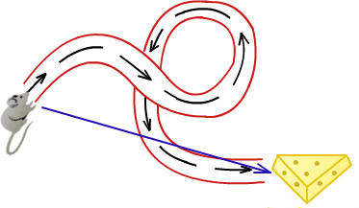
Keywords: Displacement, Distance, scalar, vector, magnitude
Learning outcomes:
Explain scalar and vector quantities
Explain the difference between displacement and distance
Be able to represent vector quantities and scale diagrams

Slide 16



Representing vector quantities
Which plane has the greater force of thrust?
Arrows are drawn to show the vector quantity. Size of the arrow represents
the size of the force.
Direction of the arrow shows the direction of the force.

Slide 17
Vector
Vectors normally have a value next to them.
The size of the vectors in a diagram is normally
proportional to the magnitude.
As one thing increases
the other increases
16 m/s²
Arrows help us show the vector direction
32 m/s²

Slide 18

Scale diagram
These are used when there are more than one force.
The line represents the size of the force and is scaled.
15N
Each 1cm ≡ 5N
≡ means represents
25N

Slide 19

Activity: Complete scale drawings for this information.
Note. Each 1cm should represent a scale. State your
scale next to the diagram.
1. There is a force of thrust to the
Left of 10N and a force of drag
To the right of 25N.
2. A balanced force of weight and
reaction force of 8N
3. A weight force of 15N and a
Thrust force to the right of 6N

Slide 20
LOb: Understand the difference between scalar and vector quantities.
Keywords: Displacement, Distance, scalar, vector, magnitude
Learning outcomes:
Explain scalar and vector quantities
Explain the difference between displacement and distance
Be able to represent vector quantities and scale diagrams

Slide 21


Scalar has magnitude but no direction.
Vector has magnitude AND direction.
Distance is the length of a path between two points.
Displacement is the shortest distance between two points.
Force arrow size is proportional to the magnitude.
≡ means represents.

Slide 22
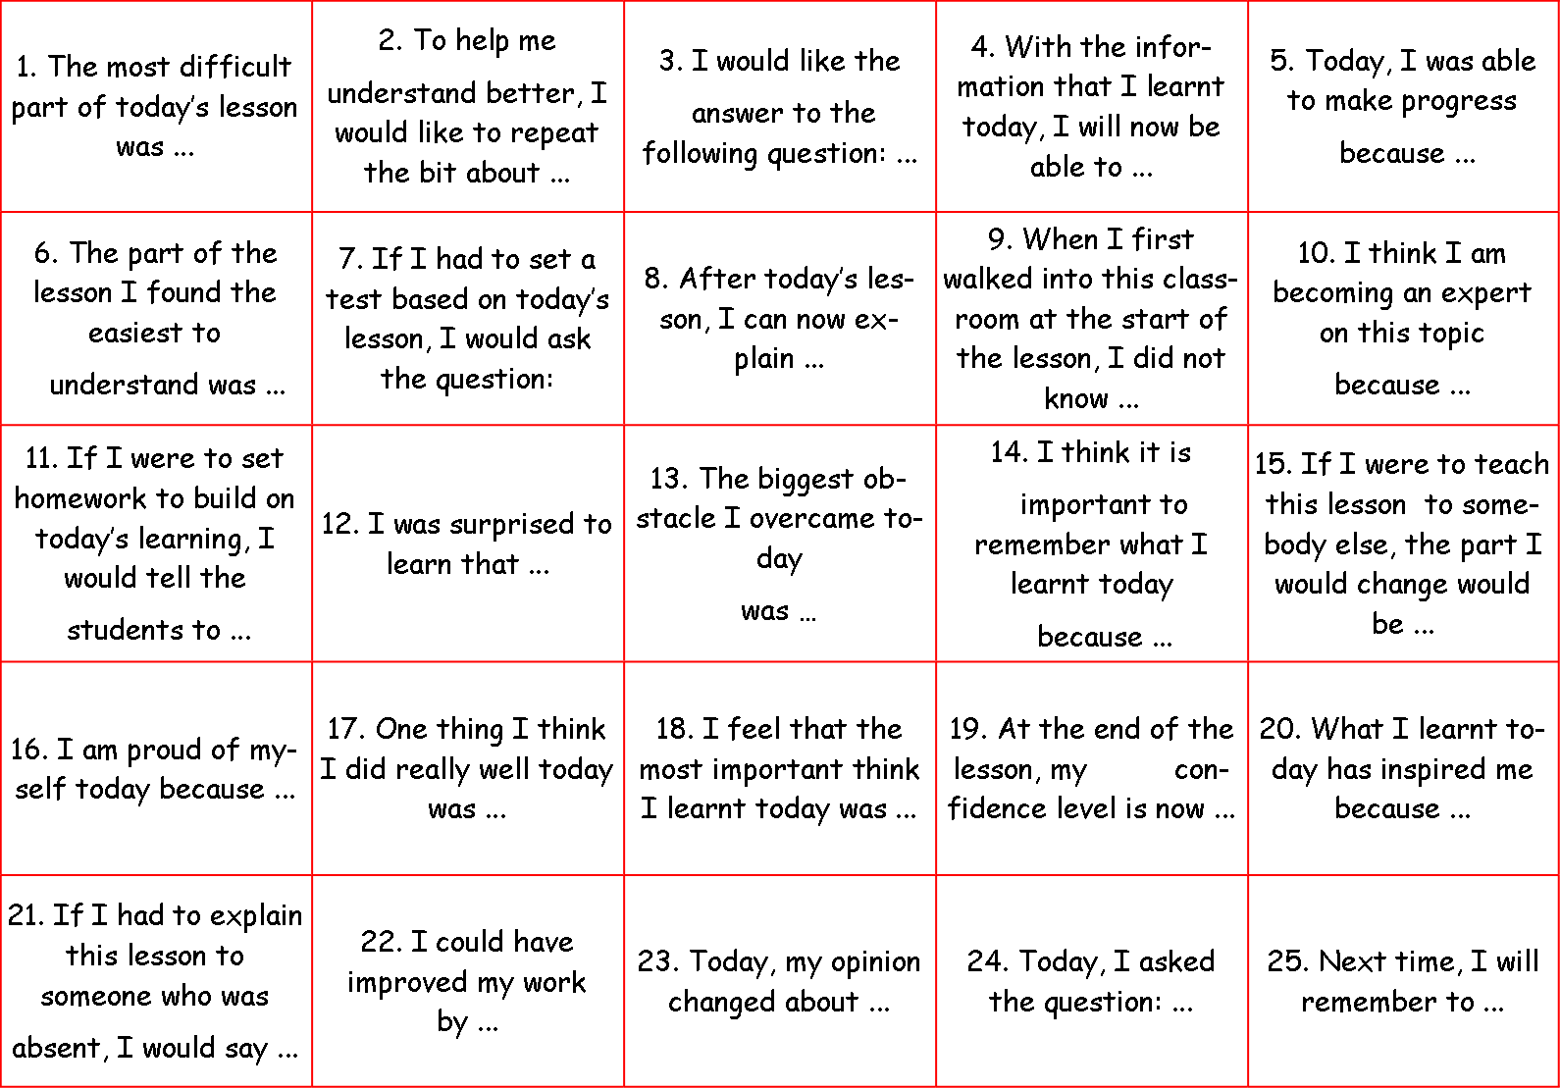

Plenary
Write and complete the sentence
to summarise your learning
LOb: Understand the difference between scalar and vector quantities

